Slide 1
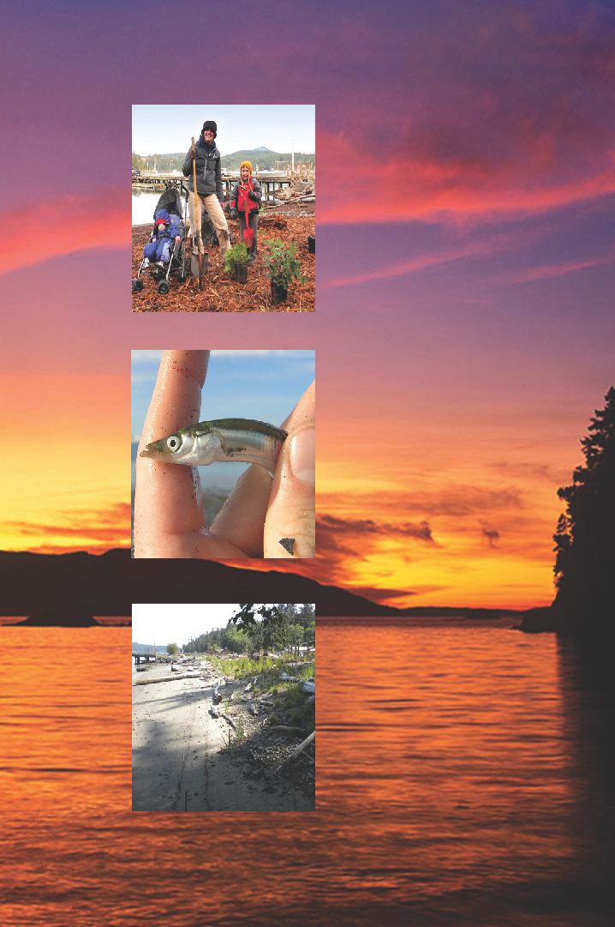
How do citizens get involved before, during & after oil spills
Linda Pilkey – Jarvis, WA Department of Ecology
NWSF Community Oil Spill Workshop

Slide 2
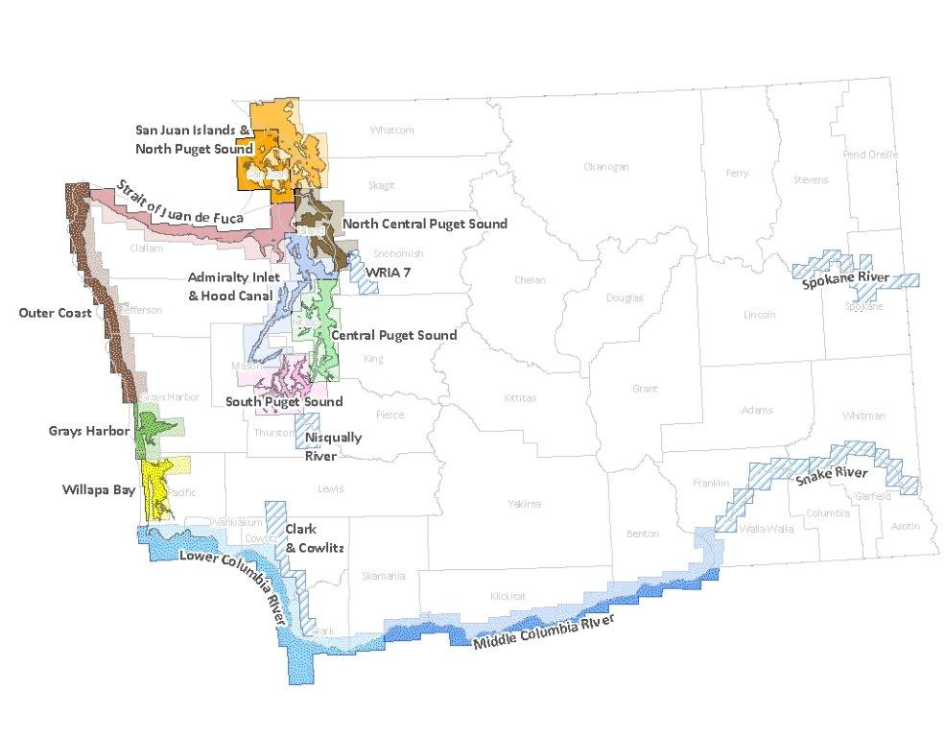
Geographic Response Plans
Middle Columbia River May 15, 2015
Green River/Duwamish May 8, 2015
Chehalis River May 8, 2015

Slide 3
Area Plan Task Forces
Operations Structure Develop guidance for land based spills and water based spills scenarios.
Plan Accessibility Edit and organize the plan for plan consistency , accessibility and reduce redundancy.
Public Affairs Update Update JIC procedures including ramp up to a large JIC, Social Media Plan template, Media Management Plan template.
Quick Reference Guide for Local and Tribal Officials Develop local and Tribal government guide to the national and area plans.
Standardizing Data Elements Define the naming conventions and data elements of a standardized situation display that creates a best practice Common Operating Picture.
Wildlife
Incorporate new National Marine Mammal Response guidelines into the plan.

Slide 4
Two-day seminar, latest in spill-recovery theory and technology including remote oil sensing technology, sinking oils, software tools and best practices.
Must register, limited space.
ecy.wa.gov/programs/spills/preparedness/BAPConference.html

Slide 5
Area Plan Volunteer Policy
Northwest Area Committee policy will give preference to:
Pre-registered
Pre-trained
Affiliated with existing volunteer organization
In-time training may be available if additional volunteers are needed
5

Slide 7
BEFORE SPILLS
Before a spill - your role is to register and stay engaged.
Look for training opportunities that may ensure your safety in an emergency and may enhance your skills to contribute.
Find an affiliated organization to join.

Slide 8
BEFORE SPILLS
What role do you want to register for?
Register as an Oil Spill Volunteer
Register as a Wildlife Volunteer
Register as Vessel of Opportunity
Register as a Volunteer Organization
Register for Multiple Volunteer Roles
Get involved with community oil spill planning

Slide 9
DURING SPILLS
During a spill - there are limited roles to contribute during a spill at this time.
Preference given to pre-registered, pre-trained and affiliated with an organization

Slide 10
DURING SPILLS
What role can you play?
Wildlife Recovery and Rehabilitation
Command Post Support
Community Ambassadors
Damage Claims Assistances
Vessels of Opportunity
Affiliated Volunteer Organizations such as Red Cross
Technical Expertise, such as knowledge of Geographic Information System (GIS) mapping

Slide 11
AFTER SPILLS
How can you help your community recover from oil spills?
Research
Training
Education
Citizen Science
Assessment and documentation of Baseline Environmental Conditions
Oil spill assessment and reporting
Northwest Area Contingency Plan Development
Spatial Planning
Long term monitoring after recovery

Slide 12
ADDITIONAL RESOURCES
Register to become a oil spill volunteer, vessel of opportunity volunteer, oilspills101.wa.gov
Register to become a wildlife volunteer, wdfw.wa.gov/about/volunteer/
Geographic Response Plans for Commenting, ecy.wa.gov/programs/spills/preparedness/GRP/Introduction/DraftGRPs.htm

